Slide 1
Python programming
unit 3a – assignment with return

Slide 2
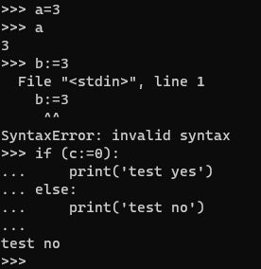
:=
=
Bind a name (or names) with a value (or values)
:=
Besides normal bind, it also return the value
Only with one value assignment, not able to do unpack like ‘=‘
Can only be used in conditional test, to test the result like a condition

